Slide 1



Welcome to our session
Neurology and MS: A Primer for Primary Care Settings

Slide 2
Session Speaker
Barry Hendin, M.D.
Multiple Sclerosis Center of Arizona
Center for Neurology and Spine

Slide 3
Financial Disclosure
All Planners and speakers/presenters of the training about to take place have no relevant financial relationship to disclose.
Arizona Alliance for Community Health Centers is accredited by the Arizona Medical Association to provide continuing medical education for physicians.
The Arizona Alliance for Community Health Centers Designates the Arizona Community Grand Rounds – Neurology and MS: A Primer for Primary Care educational activity for a maximum of 1 AMA PRA Category 1 Credits.

Slide 4


The Latest Research and Best Practices
in Treating and Managing MS
Dr. Barry Hendin
January 2025
Phoenix, Arizona

Slide 5
Mitigation Slide for Financial disclosures
Financial relationships include research, speaker, and advisor to Biogen, Novartis, Genentech, Genzyme, EMD Serono, TG Therapeutics, Bristol Myers, AztraZeneca, in topic areas of MS/ NMOSD.
I will NOT be speaking about the topics related to these relationships.

Slide 6

Agenda
Speaker Introduction
Understanding MS
Evolution of MS Diagnosis: 50 Years of Progress in MS Care
Philosophy of Treatment
The Future of MS Treatment

Slide 7
Understanding Multiple Sclerosis

Slide 8
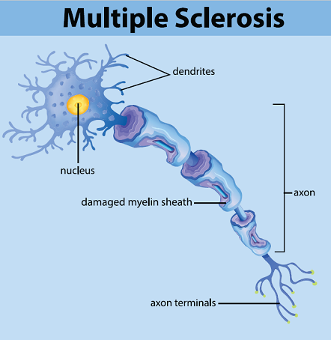
What is MS?
Multiple Sclerosis (MS) is a chronic, immune-mediated disease that affects the central nervous system (CNS), specifically the brain, spinal cord, and optic nerves. In MS, the immune system mistakenly attacks the protective covering of nerve fibers, called myelin, causing inflammation and damage. This disrupts the normal flow of electrical signals along the nerves, leading to a wide range of symptoms.
Individuals with MS may experience one or more of a variety of symptoms, possibly affecting individuals physically, emotionally, mentally, psychologically, and/or in ways that others can’t see (the “invisible” symptoms of MS). The types and severity of symptoms differ greatly between people with MS, so one person’s experience with this disorder may be very different from another’s.

Slide 9



Causes of MS
Genetic Susceptibility:
- General population risk of developing MS: 1 in 1,000.
- Risk increases to 20% in identical twins, highlighting the role of genetics.
Environmental Triggers:
- Vitamin D Deficiency: Lack of vitamin D linked to increased MS risk.
- Sunlight Exposure: Insufficient sunlight correlates with higher MS prevalence.
- Cigarette Smoking: Smoking identified as a significant risk factor.
- Epstein-Barr Virus (EBV): Strong association between EBV infection and the development of MS.
Understanding the interplay of genetic and environmental factors is crucial in addressing MS risk and prevention.

Slide 10
Biology rather than Phenotype
Phenotypes Model | Newer Model
Stages and types of disease progression in MS PRODUM (Prodromal MS) RIS (Radiologically Isolated Syndrome) CIS (Clinically Isolated Syndrome) RRMS (Relapse-Remitting MS) Secondary Progressive MS Primary Progressive MS This phenotype model allows clinicians and researchers to track MS progression, from initial signs in the prodromal phase (PRODUM) to more advanced stages like SPMS and PPMS. | This newer model emphasizes the underlaying mechanism of inflammatory vs. non-inflammatory disease activity, particularly focusing on neurodegeneration, which continue even in the absences of clinical relapse. RAW (Relapse-Associated Worsening) PIRA (Progression Independent of Relapse Activity) By distinguishing RAW and PIRA, clinicians can better tailor treatments and anticipate disease trajectories, focusing not only on relapse management but also on reducing the risk of neurodegeneration in MS. This dual approach is becoming central to modern MS management.
In MS research, a focus on "biology rather than phenotype" means scientists are investigating the cellular and molecular mechanisms driving the disease, rather than classifying patients and directing research solely by the visible clinical symptoms (phenotype).
This approach seeks to understand the underlying biological processes that fuel MS, providing deeper insights beyond just symptom-based categorization.

Slide 11
Evolution of MS Diagnosis
50 Years of Progress in MS Care

Slide 12
MS Diagnosis
Evolving Diagnostic Criteria:
Overview of how diagnostic thresholds for MS have been lowered to facilitate earlier treatment.
Emphasis on the importance of early intervention in improving patient outcomes.
The McDonald Criteria are a set of internationally recognized guidelines for diagnosing Multiple Sclerosis (MS). First developed in 2001 and updated several times (most recently at ECTRIMS 2025),
2025 Revisions Highlights
The most recent revision in 2025 aimed to further clarify DIT and DIS requirements and included:
  Refinements to MRI guidelines to improve diagnostic accuracy.
  Emphasis on biomarkers, such as the presence of OCBs, to support diagnosis in cases with limited clinical evidence.
    Neurofilament light - a protein in the body that can be measured in the blood, cerebrospinal fluid (CSF), or plasma to help diagnose and monitor multiple sclerosis (MS)
    GFAP (Glial fibrillary acidic protein) - is a biomarker that can help identify and predict the progression of MS
    Additional imaging techniques to detect subtler lesions, potentially allowing for even earlier intervention.
Early diagnosis and treatment of MS can lead to better long-term outcomes, making the ongoing evolution of diagnostic criteria essential in clinical practice. The McDonald Criteria have become a critical tool in MS diagnosis, enabling providers to balance the need for an accurate diagnosis with the goal of early, effective treatment.

Slide 13
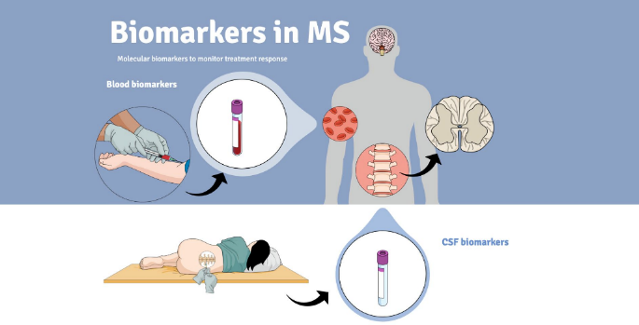
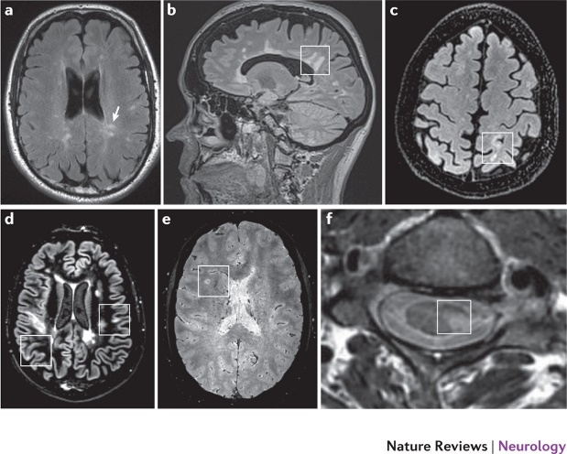
Diagnostic Advancements
Therapeutic Milestones
1993: Launch of the first disease-modifying therapy.
2023: Over 25 FDA-approved therapies now available, providing expanded treatment options.
Diagnostic Advancements
1972: First CT scan available in the U.S.
Introduction of MRI, advanced MRI techniques, scanners and humoral, biomarkers, and refined imaging methods for better diagnosis and monitoring.
Philosophical Shift
Earlier adoption of higher-efficacy treatments, marking a proactive approach in patient care.

Slide 14
Philosophy of MS Treatment

Slide 15
Shared-Decision Making
Patient-Centered Care: Puts patients at the forefront, valuing their preferences and goals.
Enhanced Understanding: Promotes open communication, helping patients understand their condition and treatment options.
Informed Choices: Empowers patients to make decisions that align with their needs through discussions of benefits, risks, and alternatives.
Improved Treatment Adherence: Active involvement increases the likelihood of following treatment plans and fosters a sense of ownership.
Emotional Support: Strengthens the partnership between patients and providers, alleviating anxiety and encouraging questions.
Long-Term Outcomes: Associated with better health outcomes, increased satisfaction, and enhanced quality of life.
Shared decision-making is essential for creating a supportive healthcare environment that prioritizes the patient's voice and promotes overall wellness in managing MS.

Slide 16
Philosophy of Treatment
When to Start Treatment What to Start | When to Switch Treatment | When to Stop Treatment
Initiate therapy as soon as a diagnosis of MS is confirmed, especially with the evolving criteria for early diagnosis. Importance of starting disease-modifying therapies (DMTs) promptly to improve long-term outcomes and reduce disease progression. | The patient experiences inadequate response to the current treatment. Side effects are intolerable or impact quality of life. Disease activity or progression is observed, as indicated by MRI or clinical symptoms. | Stopping treatment is a unique situation that requires a thorough discussion between the patient and their healthcare provider. Each case of MS is distinct; decisions should be personalized based on individual circumstances and health status. Factors to Consider: Presence of significant side effects that may compromise quality of life. Patient’s age, remission or stability of disease, overall health, lifestyle, and preferences.
Current Evidence:
While there is some data regarding treatment discontinuation, it is not comprehensive.
More research is needed to fully understand the implications of stopping treatment in various scenarios.

Slide 17

Disease-Modifying Therapies
Disease-Modifying Therapies (DMTs) for MS as treatments designed to alter the disease course by reducing relapse rates, slowing disease progression, and limiting new lesion development seen on MRI. The primary goal is to minimize long-term disability by managing disease activity and progression.
Current guidelines emphasize early intervention with DMTs, especially for individuals with a high risk of aggressive MS. For those with a stable disease course or advancing age, treatment strategies may involve de-escalation or even discontinuation of DMTs, but this requires careful consideration of the potential for disease rebound, especially with high-efficacy therapies like natalizumab and fingolimod. DMT management also considers patient-specific factors such as age, disease duration, and comorbidities to tailor the treatment plan.
This personalized approach aims to maximize patient safety while maintaining disease control.

Slide 18
Relapse Management Therapies
Managing relapses in MS typically focuses on reducing inflammation to speed recovery and lessen the impact of acute symptoms. Corticosteroids are the first-line treatment for MS relapses due to their anti-inflammatory effects. High-dose intravenous methylprednisolone (IVMP) is commonly prescribed over three to five days, which helps shorten recovery time, although it doesn’t affect the long-term course of MS.
Oral corticosteroids, like prednisone, can also be used in some cases, but IV corticosteroids are often preferred for their potency and rapid onset of action.
If a patient doesn’t respond adequately to corticosteroids, alternative treatments such as adrenocorticotropic hormone (ACTH) gel may be used.
While initially a standard option before the widespread use of corticosteroids, ACTH remains an option today, especially in patients who can’t tolerate steroid therapy. ACTH works by stimulating the adrenal glands to produce natural steroids, though it’s generally less convenient and more expensive than IV corticosteroids.
Ultimately, the specific treatment plan should be tailored to each patient’s condition and previous response to therapies, with ongoing monitoring by a healthcare provider to determine the best approach for relapse management in MS.

Slide 19
Symptomatic Treatment
Symptomatic treatment in MS aims to manage the various symptoms affecting mobility, vision, pain, cognitive function, and daily living. Symptom management varies based on the individual's needs and the specific symptoms they experience:
Muscle and Mobility Issues: Muscle relaxants, such as baclofen, help alleviate muscle spasms, while physiotherapy and assistive devices (like canes or walkers) aid mobility. Additionally, exercise programs tailored to build strength and flexibility play a crucial role in maintaining function.
Pain Management: Neuropathic pain, common in MS, can be addressed with medications like gabapentin or pregabalin. Physical therapy may also help manage pain and discomfort.
Fatigue: Energy-conservation strategies, as well as medications like amantadine, are common approaches for MS-related fatigue. Structured physical activity, including supervised exercise, can improve stamina and reduce fatigue over time.
Bladder and Bowel Dysfunction: Treatments include medications to manage overactive bladder and dietary adjustments. For severe cases, devices and intermittent self-catheterization are additional options.
Cognitive Impairments: Cognitive rehabilitation, activities targeting memory and concentration, and psychological support are frequently recommended to improve daily cognitive function.
Mental Health Support: Cognitive-behavioral therapy (CBT) and antidepressants address mental health challenges like depression, anxiety, and emotional stress, which are common in people with MS.
Visual and Sensory Symptoms: Steroids may be used during acute episodes that affect vision, while medications for sensory disturbances or nerve pain provide longer-term relief.
MS symptom management is personalized and often involves a team of specialists.

Slide 20






Complementary Treatment
Wellness
Holistic Approach: Focus on treating the whole person to enhance overall well-being.
Multidisciplinary Care: Collaboration among healthcare professionals
Nutrition: Promote a balanced diet to support immune health and manage symptoms.
Physical Wellness: Emphasize regular physical activity for improved mobility and mental health.
Cognitive and Brain Health: Engaging in activities that stimulate the brain, learning, and social engagement
Sleep Hygiene: Highlight good sleep practices for restoring energy and cognitive function.
Mental and Emotional Support: Recognize the psychological impact of MS and the importance of mental health resources.
Family and Social Connections: Staying connected with loved ones and participating in social activities can reduce feelings of isolation and improve mood, reducing the risk of depression and anxiety
Faith and Spiritual Support: Encourage spiritual practices that promote resilience and a sense of purpose.

Slide 21

The Latest Research
The Future of MS Management

Slide 22
BTKIs
Bruton's Tyrosine Kinase inhibitors (BTKis) are an emerging class of medications showing promise in treating MS.
Originally developed to treat certain types of cancers, these inhibitors target the enzyme Bruton's tyrosine kinase (BTK), which plays a key role in B-cell activation, proliferation, and antibody production.
BTK inhibitors are currently being researched as a potential treatment for MS due to their immunomodulatory effects.
  Targeting B Cells and Microglia
  Selective Immune Modulation
  These studies are evaluating their safety, efficacy, and impact on relapse rates, lesion activity, and disability progression.
  BTKis are among the few therapies being tested for both Relapsing and Progressive MS, offering hope for those with limited treatment options.
Future Outlook
If Approved: BTK inhibitors could offer a new class of treatment for MS that is effective, targeted, and potentially safer.
Personalized Treatment: BTKis could be part of a more personalized treatment approach, potentially used in combination with other therapies depending on the patient’s specific disease profile.

Slide 23

EBV Vaccine Development
EBV-MS Connection:
Recent studies show a strong association between EBV infection and MS onset.
People with MS often show evidence of past EBV infection, and the virus may trigger or exacerbate the autoimmune response that drives MS.
Reducing EBV infections, especially in early life, could potentially lower the risk of MS development.
Current Progress in EBV Vaccine Development
Several EBV vaccine candidates are under research, including those in clinical trial phases, with different approaches for preventing the virus from infecting human cells.

Slide 24
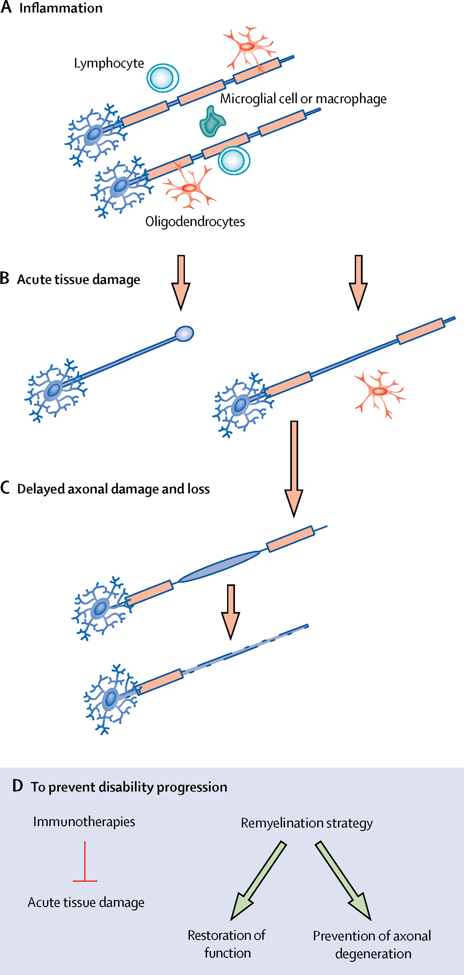
Repair and Re-myelination
Work in Progress
Repair and remyelination therapies aim to restore this myelin sheath, potentially reversing neurological damage and improving function.
This field represents a hopeful frontier in MS research, as effective remyelination could reduce long-term disability and enhance quality of life.

Slide 25
Final Tips & Takeaways
Early Diagnosis and Intervention Are Key
Targeted Treatment Approaches
Importance of Holistic Wellness and Lifestyle
Shared Decision-Making Enhances Care
Multidisciplinary and Supportive Care
Hope on the Horizon
With advancing science, personalized medicine, and a holistic approach, the future of MS management is becoming more hopeful. By combining early intervention, cutting-edge therapies, and patient-centered care, individuals with MS can look forward to better outcomes and a more fulfilling quality of life.

Slide 26

Your Questions Matter!

Slide 27

Thank you
Please complete this survey:

